Slide 1
抵御动态威胁的智能防护 Eva Chen 首席执行官兼联合创始人

Slide 2


企业边界逐渐消失
Notes:
The Cisco® Visual Networking Index (VNI) Global Mobile Data Traffic Forecast Update
Netscope Cloud Report, April 2014

Slide 3


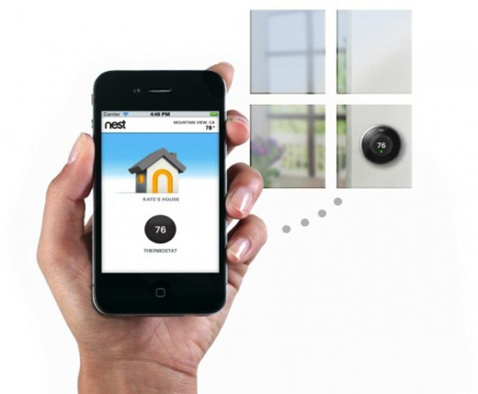
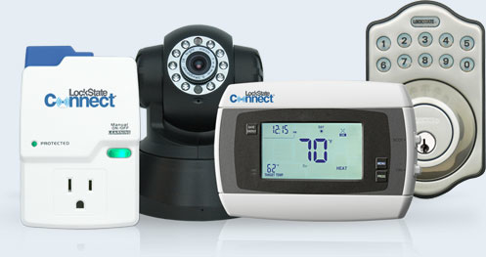
目前移动连接设备的数量已超过人类数量！
到 2018 年，35% 的消费者拥有的智能手机和平板电脑将用于工作中 (BYOD) ²
到 2018 年，我们将人均拥有 1.4 部移动连接设备¹
1) Cisco® 视觉网络指数 (VNI) 全球移动数据流量预测更新，2014 年 2 月；2) Juniper Research，2013 年 11 月

Slide 4







越来越多的关键信息迁移到云
90% 的大型企业和政府机构将使用云²
461 个企业云应用程序，是 IT 预估数量的 10 倍 之多¹
1) Netscope 云报告，2014 年 4 月
2) Forrester 研究，2013 年
Notes:
The Cisco® Visual Networking Index (VNI) Global Mobile Data Traffic Forecast Update
Netscope Cloud Report, April 2014

Slide 5





威胁越来越复杂，专门针对存储在物理、虚拟和云服务器中的敏感数据
复杂性
员工数据泄露
漏洞利用
传统恶意软件
高级恶意软件
针对性攻击
时间

Slide 6

今年预期动态
恶意攻击者将变本加厉地利用新漏洞、点击劫持、水坑式攻击、移动威胁载体
随着供应商结束对 Java 6 和 Windows XP 的 支持，会有更多漏洞被加以利用
每个月将发生一次重大数据泄露事件
随着隐私问题的增多，公众不信任度将提升
恶意攻击者将利用 Deep Web，使全球执法者陷入更艰难的斗争中
来源：趋势科技前瞻性威胁研究

Slide 7

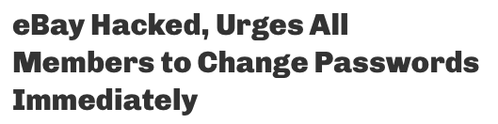
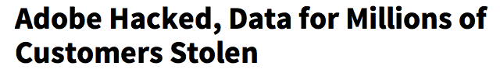
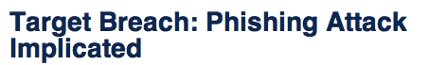
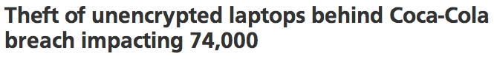
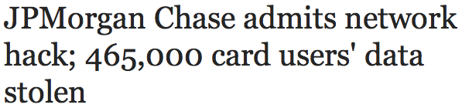
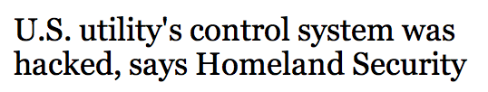
在 2013 年，有超过
7.31
亿条记录
因黑客攻击和 web 危害而失窃。¹

Slide 8

目前的现实状况
63% 的安全专家认为，他们的企业成为攻击的目标是迟早的事情¹
78% 的网络间谍攻击利用电子邮件²
定向攻击造成的平均损失高达590 万美元³
来源：
1. ISACA APT 认知研究，2013 年
2. Verizon，2014 年
3. Ponemon，2014 年 5 月

Slide 9

主要业务担忧：不再只是成本问题！
知识产权流失
收入损失
合规性
品牌形象受损
负面宣传
个人、职业信誉

Slide 10

有 1.1 亿条记录泄露
80 桩民事诉讼
42 亿 美元
5 月份，经验丰富的首席执行官辞职
接下来 还会发生什么？
2013 年利润下降 34%
总成本达 10 亿 美元
3 月份， 首席信息官辞职
7 名董事成员目前面临风险

Slide 11
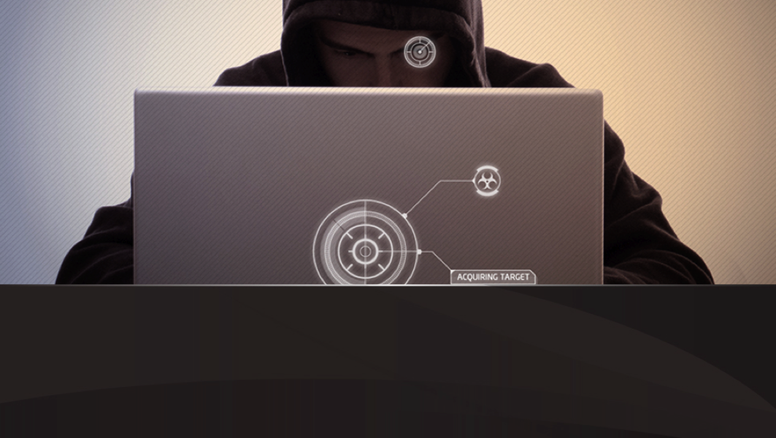
黑客优势力压白客！
容易获得武器和高技能人员
入门容易
专注于目标
失败后代价轻微

Slide 12
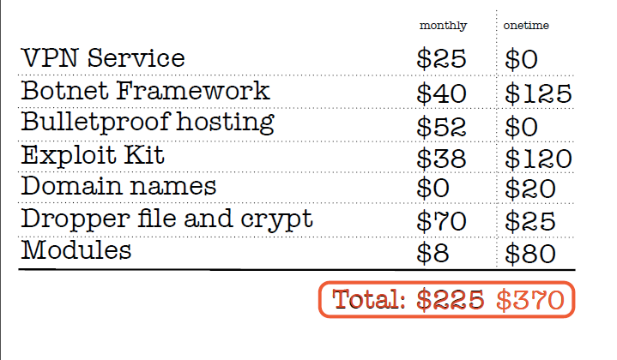
黑客优势力压白客！
来源：趋势科技前瞻性威胁研究

Slide 13



标准的防御不再好用
Next-gen Firewall
Advanced reconnaissance
Spear-phishing emails
Embedded payloads
Unknown malware & exploits
Dynamic command and control (C&C) servers
BYOD and remote employees create a broad attack surface
Intrusion Detection (IDS)
Intrusion Prevention (IPS)
Traditional
AV
Email /Web Gateways
Advanced methods can evade traditional defenses
Notes:
The reality of targeted attacks is such that your existing security defenses are blind to advanced malware and attack methods they were not designed to address.
Given advanced threats can be unknown, use delivery methods that may circumvent some or all of your traditional defenses, and by nature, tend to evolve based on the needs of the attacker, it is important to know some of the methods attackers employ:
Advanced reconnaissance – hacker will research and identify the network, infrastructure and defenses you have in place. They will use this insight to custom design and weaponize malware to evade your existing security systems
Spear-Phishing Emails – as part of their research, attackers will take aim at employees, contractors, suppliers and other targets who are researched and targeted with socially engineered emails
Embedded payloads - attackers can embed lethal payloads within URLs, documents, files, PDFs, other attachments and application exploits. This combined with the socially engineered attacks become the conduit for the attacker’s malware to evade detection and enter your network.
Dynamic command and control – similar to redundancies you build into your network’s attackers utilize dynamic attack infrastructure along with back up alternatives. In other words the command and control servers can range from an IP address you might already trust to a third party service used by attackers to a third party you many not know and evolve as needed
BYOD & Remote Employees – with a rapid increase in the use of smartphones and tablets, along with employees utilizing third party networks with these devices adds to the points of vulnerability that can be used by attackers

Slide 14

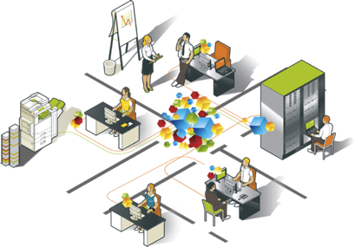


黑客一直在不断试探找出您的安全漏洞
Limitations in device/OS/file coverage
Unmonitored ports and protocols
Generic sandbox environments
Limited insight on known and zero-day attacks
Lack of visibility into attack evolution & polymorphic malware
Notes:
The intent of this slide is to educate the customer on the general gaps that exist in competitive offerings given the attacker behaviour outlined in slides 13 through 20. Note the caution sign is analogous to the rating FireEye received from the NSS Labs Breach Detection Systems Test
Ports and protocols that are not monitored are akin to providing attackers with a ‘hall pass’ to roam your network at will. Depending on your customer the following blog post may be of value (note: do not send…read first and determine if it is suitable for your customer: http://blog.trendmicro.com/cookie-monsters-targeted-attacks-advanced-threats-demand-pay-attention-caution-signs/#.U4vLEK1dXFQ
Any devices, operating systems or files that are not monitored are also sources of attacker entry points. For example, we have found malicious activity from smart phones and tables and even medical devices …. If the devices has an IP address then all activity to and from the device should be monitored. In some cases we offerings with limitation in the type of size of file it can analyze…again providing attackers with a crevice within which they can hide their malware and attack payloads.
Having a sandbox environment is not enough. The phrase ‘targeted attack’ was adopted for a reason. Attackers purpose build windows license, language and other settings checks into their malware. Meaning, a one size fits all sandbox environment is a ripe place for malware to not detonate and for a potential attack to pass through undetected.
Further, despite the cloak and dagger attention on targeted attacks – it is important to know that attacks such as the one on the US retail giant Target, use known malware. Further, what may be a zero day exploit on Monday could very well be a know attack by Friday. The point being, sufficient attack intelligence is not just about the type of attack. Anyone who suggests they are specialists in zero day exploits or maybe juty known malware is being myopic.
- Given the dynamic nature of targeted attacks, and, the fact this is driven by the inate desire of an attacker to evade detection, the ability to detect and monitor any changes in an attack and/or changes in known or unknown malware are also key. Attackers readily change command and control servers, IP addresses, malware functionality, attack methods and more. Without this insight … you may detect an attack on a Monday but be oblivious to a cloaked version of the same attack a day or hours latter.

Slide 15










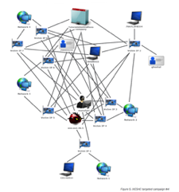
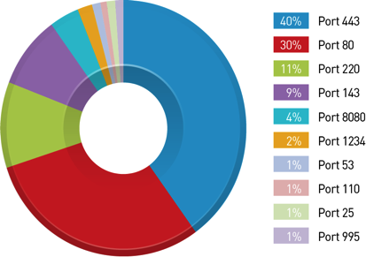
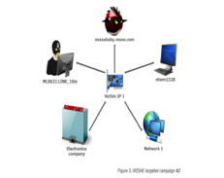
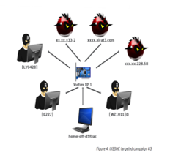

黑客采用定制以及定向的攻击来逃避您的防御
攻击的最弱一点: 人
使用多种协议
91% 针对性攻击开始于钓鱼邮件
EvilGrab 恶意软件
使用多种传输端口
攻击随着时间不断演化
Poison Ivy
IXESHE MW
Confidential | Copyright 2014 Trend Micro Inc.
Notes:
They key point to keep in mind, that despite the time, money and resources you have invested in your security defenses, every defense has an achilles heal. What we find in common, and again based on research by Trend Labs, a whopping 91% of targeted attacks being with a spear phishing email. In short spear phishing emails are to targeted attacks as what a large wooden horse was to the Trojans. What may appear like an acceptable and normal interchange between people is actually cloaking an offensive operation.
Techniques to bypass traditional defenses:
Advanced reconnaissance
Spear-phishing emails
Embedded payloads
Unknown malware & exploits
Dynamic command and control (C&C) servers
BYOD and remote employees create a broad attack surface
As part of their modus operandi, attackers consciously select the ports that are used as part of the attack. Further, as evading detection is key to the success of an attack…. as evidenced by research completed by Trend Labs… this Poison Ivy malware sample used over ten ports. The point being … you may find it on port 80 …but unless you are monitoring all ports ..how will you know this, or any other malware, is being delivered or communicating our of your network?
Similar to the use of varying ports, attackers change the protocols and applications that are used in an attack. Also based on research by TrendLabs, we can see this EvilGrab malware used http, pop3, internet explorer, email, smtp, outlook, imap, and windows messenger. Again the intent of the attacker is to be nimble and avoid detection. As with the network ports, attackers select the protocols and applications they will use based on their reconnaissance and assessment of what will lead to the highest level of success.
As if the evolving nature of ports and protocols was not enough attackers will also change the means, methods and structure of their attack. They will use multiple command and control servers, vary the points of attack, the types of malware, points of vulnerability, attack channels, methods and structure to suit their needs. What you may detect and think you have a handle on Monday may vary well change by latter that day or week.

Slide 16

长尾问题
使用加壳软件
一次性域
鱼叉式网络钓鱼
针对性攻击
普遍性
已知良好/有害
传统启发性检测
未知 (90%)
实体

Slide 17

长尾问题
蜜罐技术
传统防御
样例
Akamai
（无法保护您看不到的内容）
普遍性
已知良好/有害
来源？
传统启发性检测
未知 (90%)
解包？
实体
沙盒？
漏洞防御？
大数据？

Slide 18
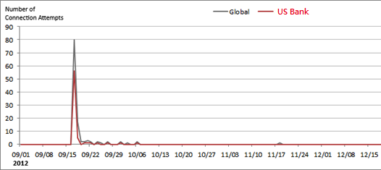
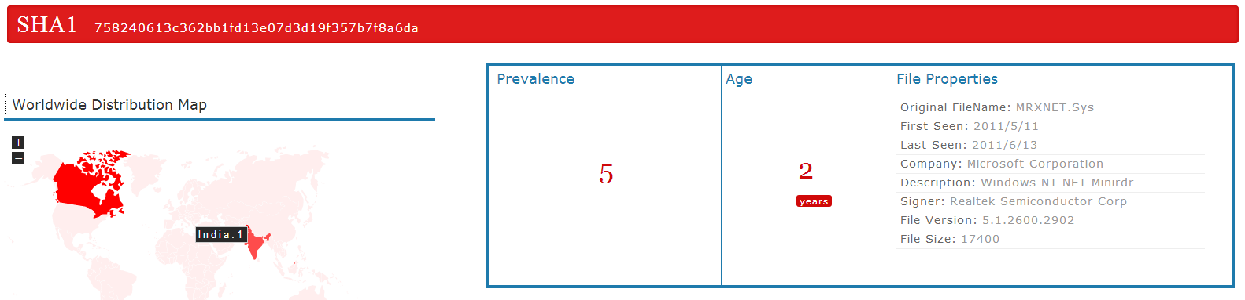
大数据情报
未知
未知
文件
已访问
域
百万分之一事件
包含大数据情报…
集中发生在特定小区域
有不寻常的大量访问
文件
已访问
域
异常

Slide 19

您公司的情况又是如何？
Sample Threat Types Detected | Presence
Advanced malware | 98%
Active botnet | 94%
Disruptive applications | 88%
Banker malware | 75%
Malicious documents | 75%
Zero-day malware | 49%
Network attacks | 84%
Android malware | 28%
Source: Real-life proof-of-concept sample results (conducted by Trend Micro technical team in 2013)
Notes:
Collected from real-life POCs of Deep Discovery conducted by Trend.
The key points are:
Most customers have already been breached but are not aware of it
The range of breaches ranges from Known Malware and malicious documents to zero day exploits and mobile attacks
In short, customers likely have a false sense of security, have already been breached, likely multiple times and are not aware of it

Slide 20

您也许担心
我们是否已经被黑了？
对我们的生意影响多大？
我们如何预防未来的威胁？
Notes:
The issue at hand is not knowing what you do not know. The fact is your organization may well have been subjected to one or more breaches without your knowledge. Further, in addition to knowing if you are subject of an attack, the key action is to understand both the nature of the attack, and, the potential level of damage that can occur.
The important points to make are that it is not just about identifying advanced malware. It is all about establishing context and providing insight to enable a cohesive strategy to detect, analyze and respond to targeted attacks. Merely setting of an alarm bell is useless without knowing what caused the alarm, when, what the impact is, how long it has been occuring, how widespread the issue is and what options exist to take corrective action.
CISO face a number of competing demands:
Defend against multiple points of attack
Constrained by budget, process & resources
Very diverse IT / Security environments
Data rich yet insight poor
Specialized expertise required to detect, analyze, adapt and remediate an attack
Spread thin: Motivated & remunerated to ensure integrity of all corporate data, assets, information and communication
Yet they must know who is attacking them, the depth of the attack, what data has been obtained, the length of the attack and how to stop it.

Slide 21
需要智能防护来应对全方位的威胁
评估潜在漏洞， 主动防护终端、 服务器和应用程序
自动更新防护，确定补救区域优先级，加固防护
响应
阻止
监视和 控制
侦测标准防御无法发现的高级恶意软件、行为和通信
分析攻击与攻击者的风险和性质，回顾性评估威胁带来的影响
分析
侦测

Slide 22
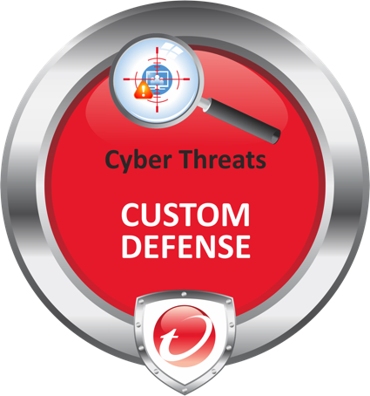




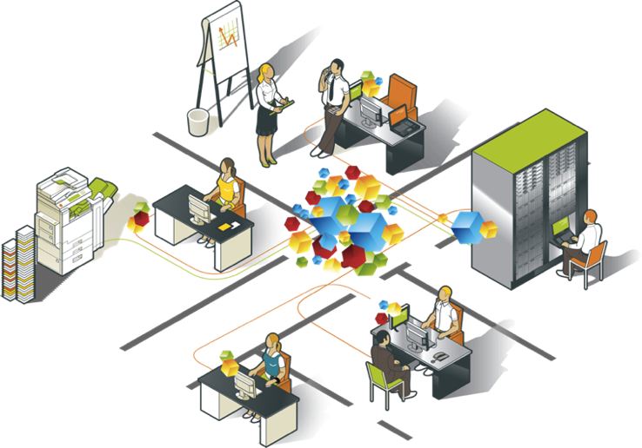
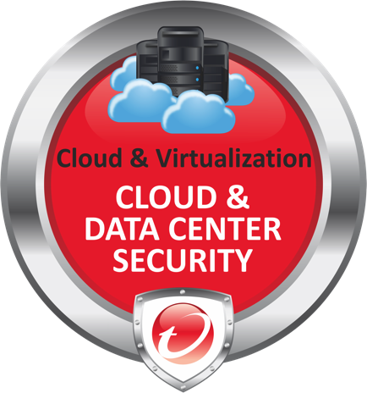





Cyber Threats
Attackers
Cloud &
Virtualization
Consumerization
Employees
IT
Notes:
As I discussed in August, we feel that the 3 biggest challenges facing our customers today are Consumerization, the growth of emerging technologies like Cloud and Virtualization, and evolving Cyber Threats. And we have 3 solutions that are specifically targeted at these problems.

Slide 23



CENTRALIZED VISIBILITY & CONTROL
CENTRALIZED VISIBILITY & CONTROL
Notes:
These solutions are supported by our ongoing investment in core technology including our big data-driven global threat intelligence, Smart Protection Network.

Slide 24




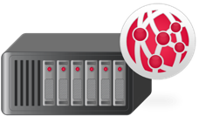



沙盒技术
设备控制
行为监控
文件信誉
网络
取证
漏洞防护
Web 信誉
网关
DLP
电子邮件 信誉
电子邮件网关 或服务器
解包
加密
内存检测
应用程序 白名单
SharePoint 服务器
中断命令和指挥

Slide 25




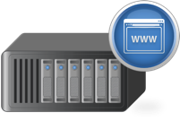



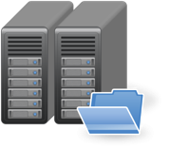


需要广泛的功能…
电子邮件安全
移动安全
高级威胁防护
安全 Web 网关
端点防护
应用程序控制
SharePoint 安全
加密
DLP

Slide 26


…但是不需要过多的控制台！
没有相互联系的 威胁响应
及时性较低
成本较高
工作负荷较高
!#$%*?!
电子邮件安全
移动安全
高级威胁防护
IT 安全
安全 Web 网关
端点防护
应用程序控制
SharePoint 安全
加密
DLP
Notes:
----- Meeting Notes (1/2/14 14:37) -----
Timeliness, not just workload. To react quickly enough. Formatting on the bubble.

Slide 27
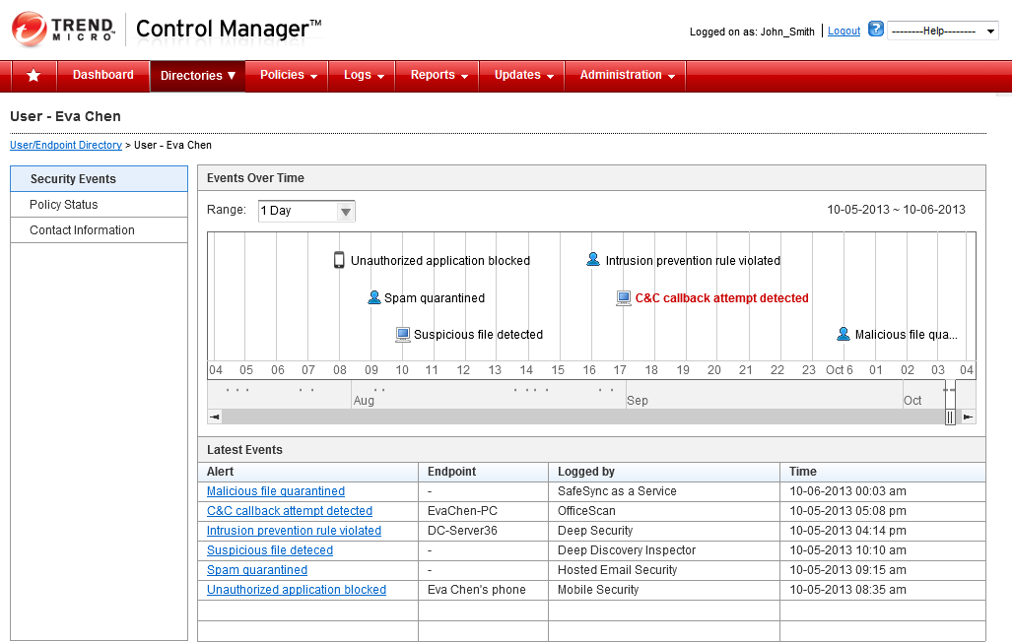
Notes:
CISO realizes that Eva has been targeted – wonders who else has been affected??

Slide 28
CENTRALIZED VISIBILITY & CONTROL
Notes:
These solutions are supported by our ongoing investment in core technology including our big data-driven global threat intelligence, Smart Protection Network.

Slide 29

安全原则不变…
自适应
感知性
智能、动态配置 和策略实施
工作负荷和应用程序感知
软件优化
平台覆盖
…但保障安全的方法 必须改变
针对虚拟化 和云基础架构 进行优化
覆盖数据中心 和云的全面功能

Slide 30


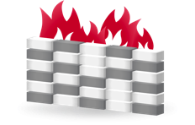


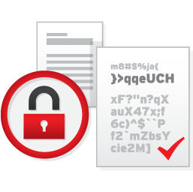
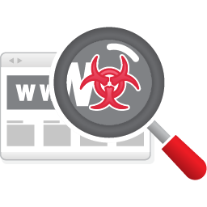
自适应
感知性
智能、动态配置 和策略实施
防止 入侵
工作负荷和应用程序感知
主机 防火墙
完整性
监控
软件优化
平台覆盖
防恶意软件
日志检查
针对虚拟化 和云基础架构 进行优化
覆盖数据中心 和云的全面功能
数据 防护
应用程序 扫描

Slide 31














入侵预防
主机防火墙
完整性监控
防恶意软件
日志检查
数据防护
应用程序扫描

Slide 32
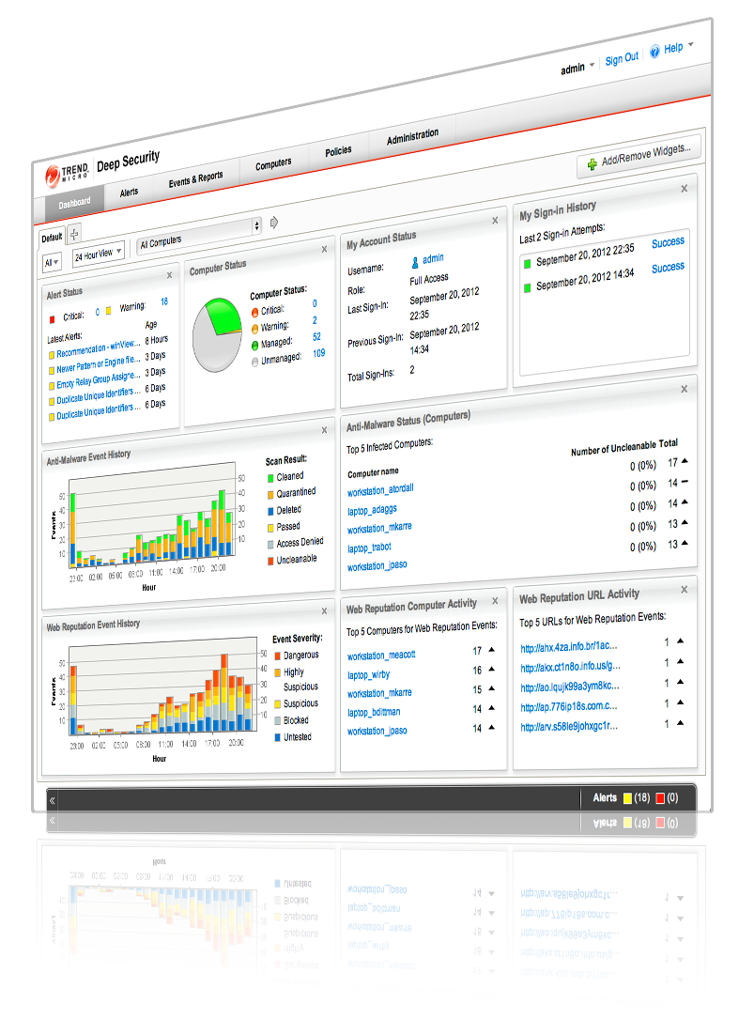
保护您的数据中心和云环境的成熟服务器以及Web应用安全
保护物理，虚拟和云环境
集中唯一的管理平台
针对虚拟化和云进行了优化
Notes:
This solution provides comprehensive protection through a single platform and administration.
It is truly optimized for virtual and cloud environments…
In a VMWare environment, the essential capabilities are provided in a way that automatically protects each VM without requiring dedicated software for each VM. This is called “agentless” security. This approach maximizes security without compromising efficiency.
This solution is also optimized for Amazon Web Services, enabling you to automatically apply the appropriate security as you spin up new instances.

Slide 33





为我们的客户全程护航，帮助他们迈向云端
“大型国际运动产品制造商”
在提供托管云服务方面占据巴西市场领先地位
帮助企业履行共同承担的安全责任
将云运用到扩展临时活动中
可自动检测新实例并应用全面安全措施
即便自动缩放也必须提供审计证明以满足 PCI 合规性
日本第一家基于云的卡支付服务提供商
3 个月内获得 PCI DSS 合规验证

Slide 34
CENTRALIZED VISIBILITY & CONTROL
Notes:
These solutions are supported by our ongoing investment in core technology including our big data-driven global threat intelligence, Smart Protection Network.

Slide 35



不同组织应对高级威胁的方式有所不同
“I need to know if any part of my network is being breached!”
“I want to add advanced threat detection to my existing Trend Micro investments!”
“I have to block emails containing advanced malware from ever reaching my employees!”
网路
信息安全
邮件

Slide 36
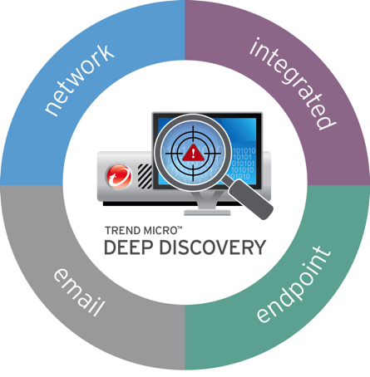

高级威胁防护可以部署在任何问题容易发生的地方
网络中发现威胁
Identify advanced malware, C&C communications and attacker activities with 360-degree monitoring
集成沙盒
Improve the threat protection of your existing Trend Micro security investments
定向攻击邮件的
发现发现
Stop the spear-phishing attacks that lead to a data breach
终端威胁的
调查与处理
Investigate & respond to attacks with network detection + endpoint intelligence

Slide 37
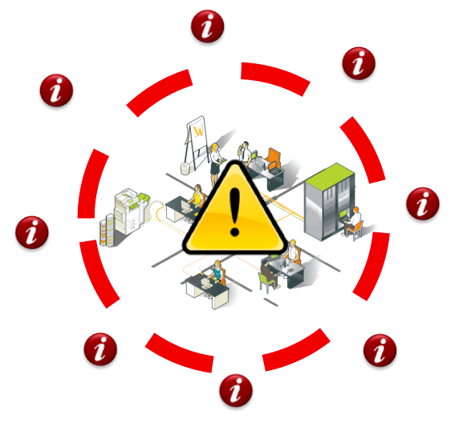
提供一个全方位的高级威胁防御方案
Software & Devices
Attack
Evolution
80+ Protocols
& Applications
Unknown Threats
& Exploits
Known
Threat
Insight
All Network
Ports
Notes:
Software & Devices
Agnostic to devices, operating systems and network traffiic
Ability to detect network threats activity emanating from any IP based device…detects attacks across all network traffic
Provide customized sandbox to match the environment that will be targeted
Handles BYOD and other complex environments. Detection beyond Windows: mobile, Mac, Android, legacy systems and specialty devices
Communication Protocols
Monitor over 80 protocols and applications such as ftp, smb, irc, http, smtp, and many more
Network Ports
Monitor all network ports …not just a small subset
Known Threats
Heuristics and patterns
Signature based malware
Known C&C, IP, Files, mobile apps and more
Unknown Threats
Malware, exploits and zero day attacks
New C&C servers and other attacker behaviour
Attack Evolution
North – south and east – west attack patterns (ie: lateral movem

Slide 38

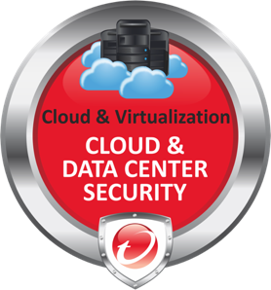
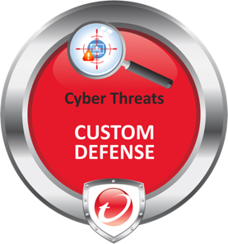


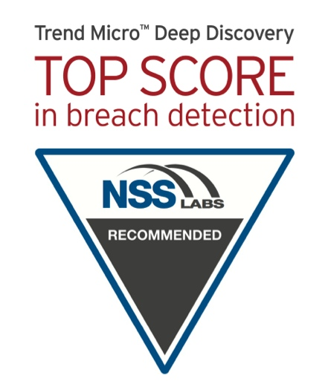


市场的领导地位
A “Leader” in the MQ
for Endpoint Protection
12 consecutive years
#1 in protection and performance
Magic Quadrant for Endpoint Protection Platforms, Gartner, January 2014
http://www.av-test.org (Sept 2013 – Feb 2014 test results, Corporate Solutions on Win XP,7 , 8 Systems)
IDC, Worldwide Endpoint Security 2013-1017 Forecast and 2012 Vendor Shares, August 2013
expertON Group, Cloud Vendor Benchmark, June 2014
2014 NSS Labs Breach Detection Tests

Slide 39
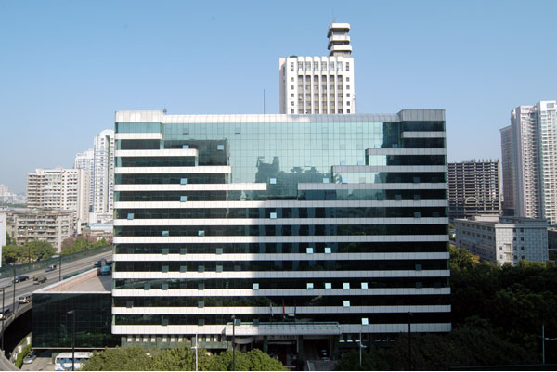

如何降低21个分支机构超过5万台终端的病毒感染率、以及解决虚拟化安全与性能的冲突是公司安全运维的挑战。
了解到主动式风险预警是降低威胁扩散、多重感染的有效手段，以及在虚拟化环境使用专用安全方案的必要性。
在多次交流及测试验证后，公司分期分批在省公司及市公司部署了趋势科技威胁预警方案TDA及虚拟化安全防护方案Deep Security。
“通过TDA对威胁主动发现的预警能力，能快速定位零日威胁并及早处理，有效降低全网病毒感染率。同时，Deep Security能够利用虚拟化平台专用API接口提供定制防护，兼顾了安全及性能，解决了公司安全运维的两大需求。”

Slide 40
趋势科技智能安全防护云SPN应对不断变化的威胁
Range of threat defense capabilities, including ‘next-gen’ approaches
On-premise and in cloud
End Users – Servers – Network Physical – Virtual – Cloud
Across layers and environments
Connected to cloud-based global threat intelligence
Global threat intelligence
RESPOND
PREVENT
MONITOR & CONTROL
ANALYZE
DETECT
Notes:
Range of threat defense capabilities, including ‘next-gen’ approaches
Applies layers and environments
On-premise and in cloud
Connected to cloud-based global threat intelligence

Slide 41
谢谢！

